Slide 1
Omnidirectional Mobile Robot

Slide 2
Contents of This Project
Robot Assembly.
Kinematic Model Theoretical.
Kinematic Model Python Node (Subscribe Robot Speed, Publish Wheels Speeds).
URDF.
Arduino C Node ( Subscribe Wheels Speeds, Mapping These Speeds From 0 To 255 To Each Wheel And Its Direction).
⁠Gazebo Simulation.

Slide 3
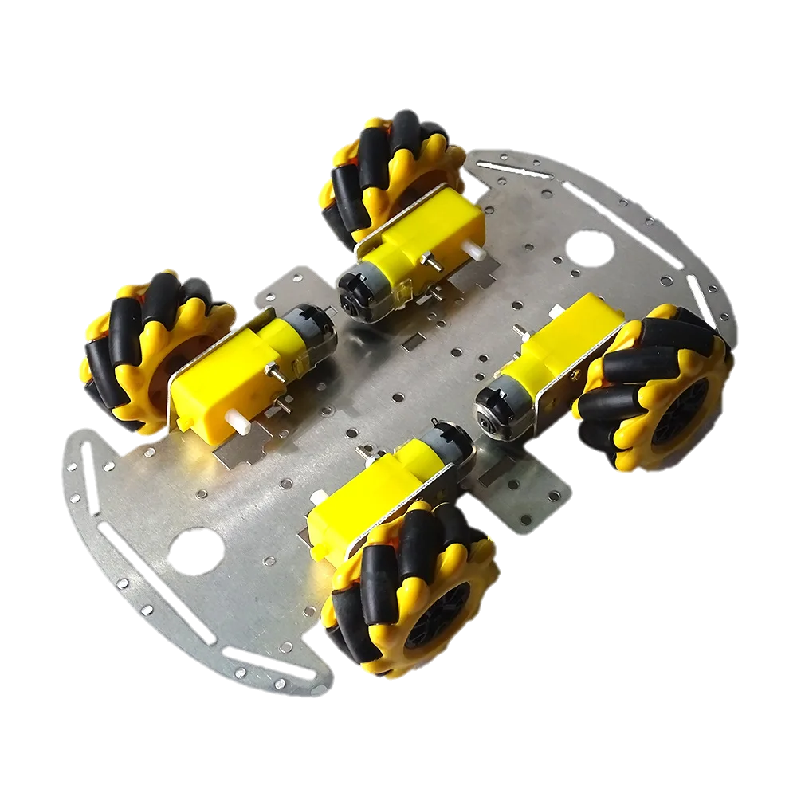
Robot Assembly.
We carefully selected components such as motors, wheels, chassis, macnum wheels and sensors to create a versatile and maneuverable platform. The emphasis was on achieving omnidirectional movement for enhanced agility.

Slide 4
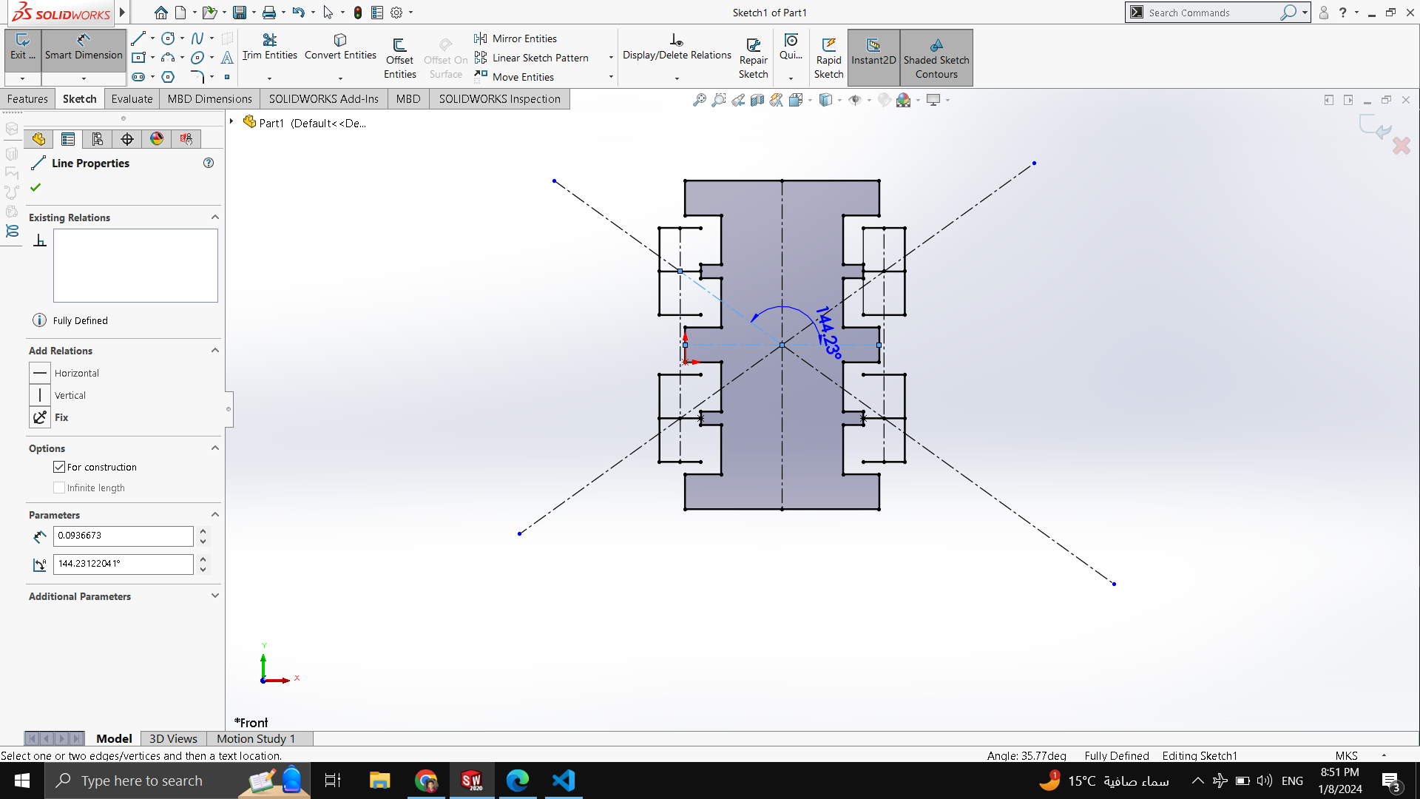
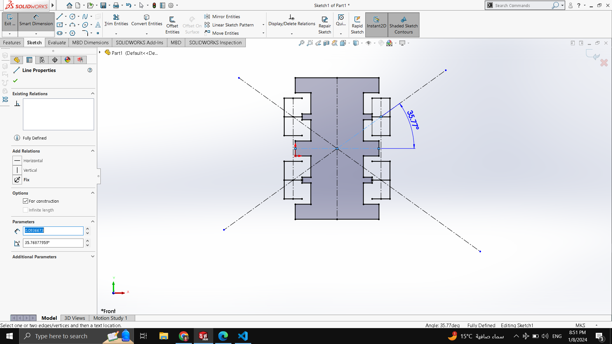

Kinematic Model Theoretical
We made a solidworks model to illustrate the required angles

Slide 5
Kinematic Model & Python Node

Slide 6
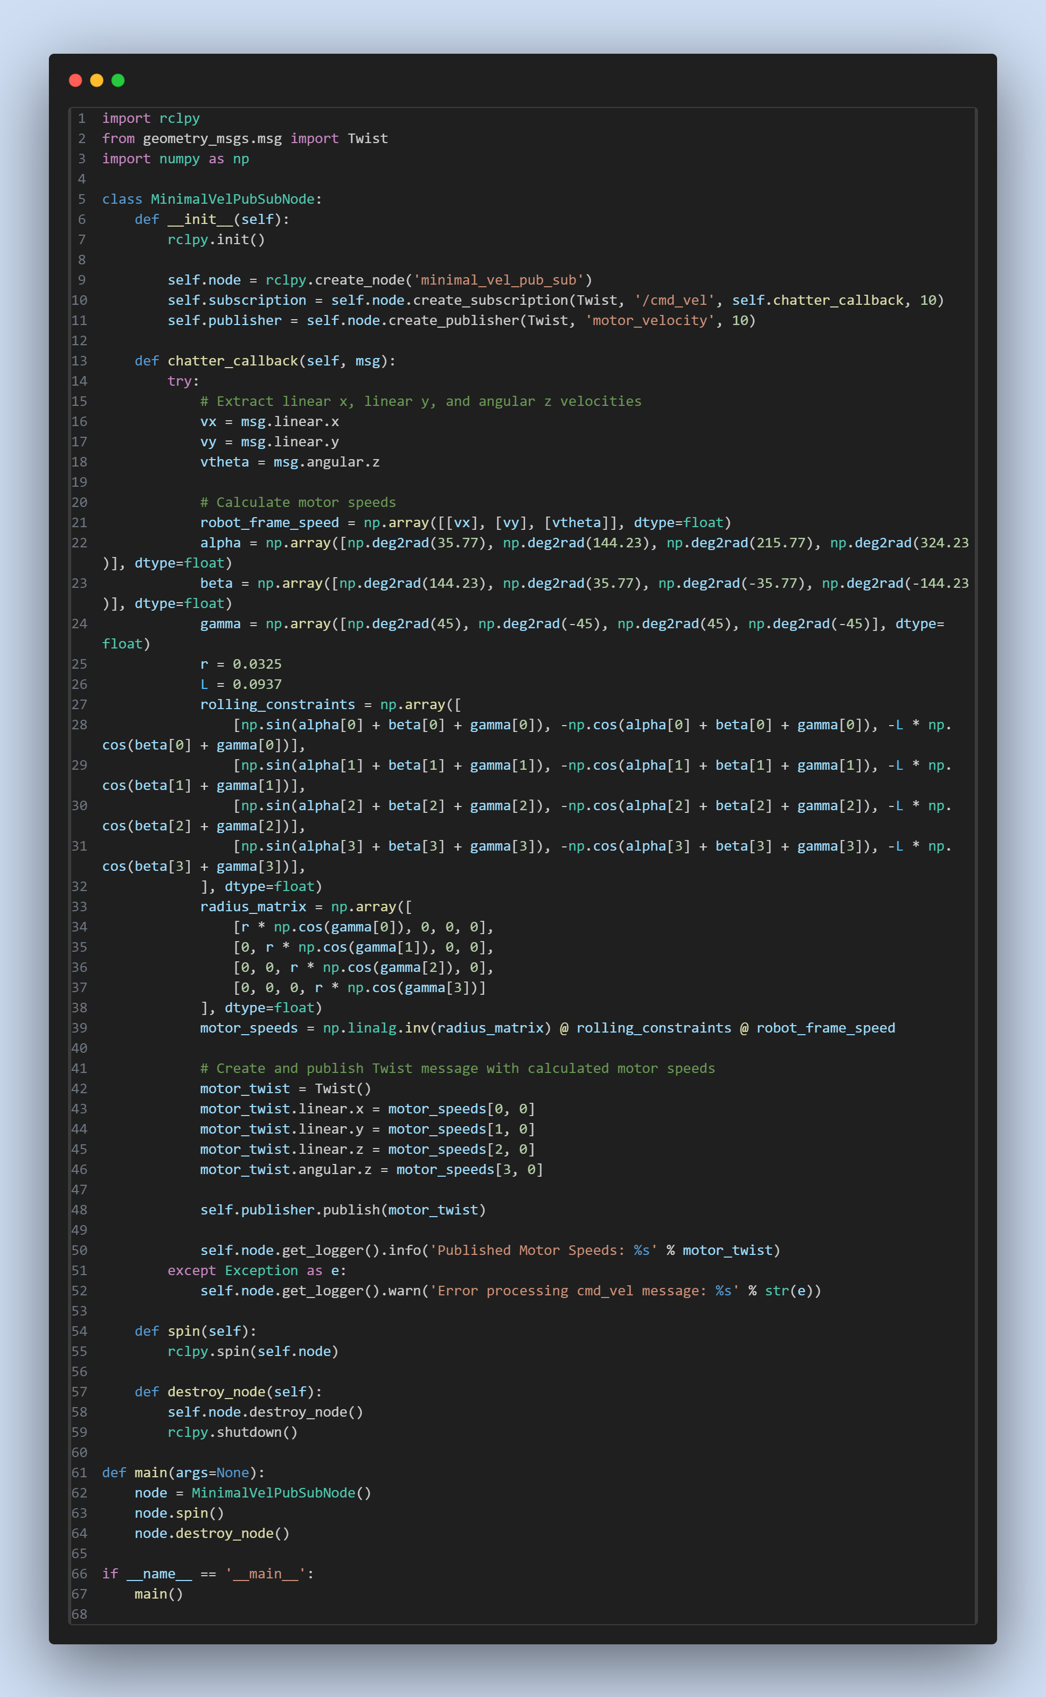

Slide 9
RosSerial Problem Vs. Solution
How did we deal with rosserial

Slide 10
Problem
There is no direct equivalent of the rosserial package in ROS 2 . Rosserial was designed for ROS 1 to enable communication between microcontrollers (like arduino) and ROS nodes over serial communication.

Slide 11
Solution
To Tackle this Problem we used the ROS Bridge, which serves as a vital component in facilitating communication between different ROS systems, and it can be employed to bridge the communication gap between rosserial in ROS 1 and ROS 2 environments.
While rosserial was initially designed for ROS 1 to enable communication between microcontrollers and ROS nodes over serial communication, the ROS Bridge can be used to extend this communication to ROS 2.

Slide 12
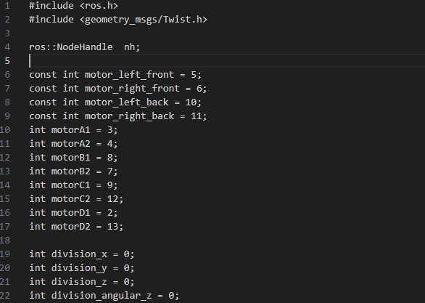
Arduino Code

Slide 13
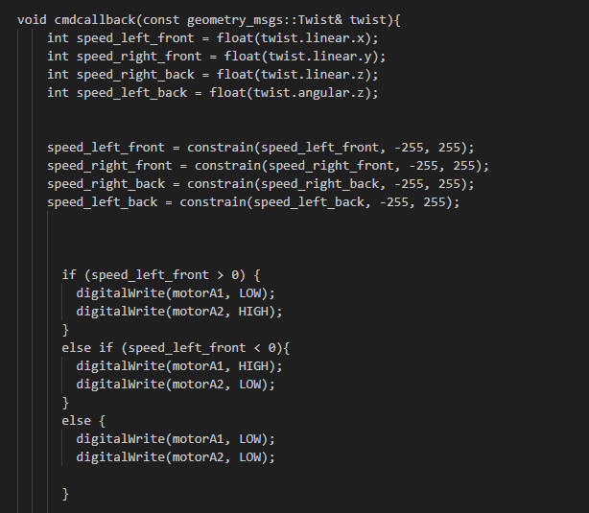

Slide 14
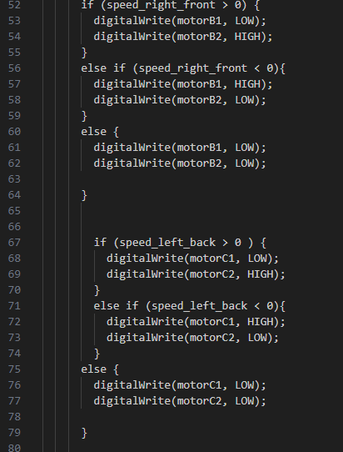

Slide 15
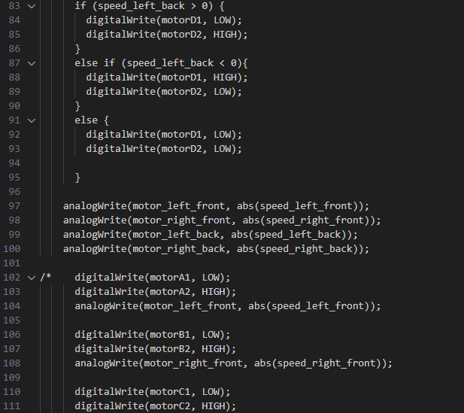

Slide 16
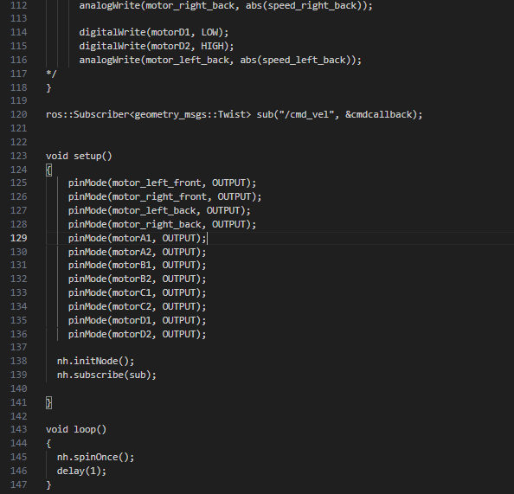

Slide 17
URDF

Slide 18
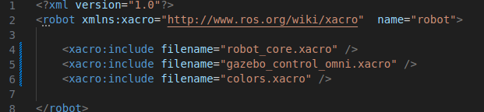
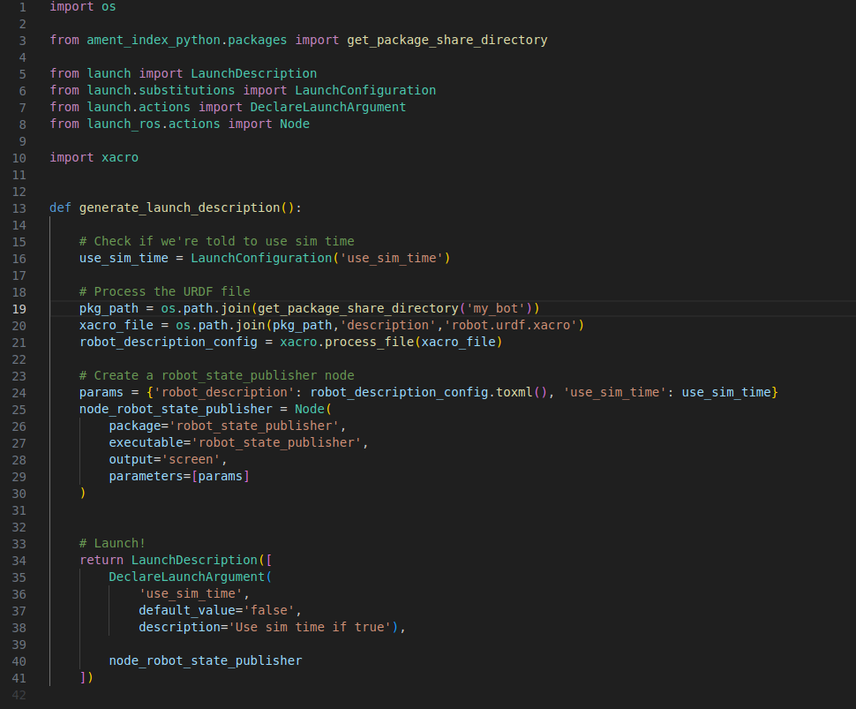
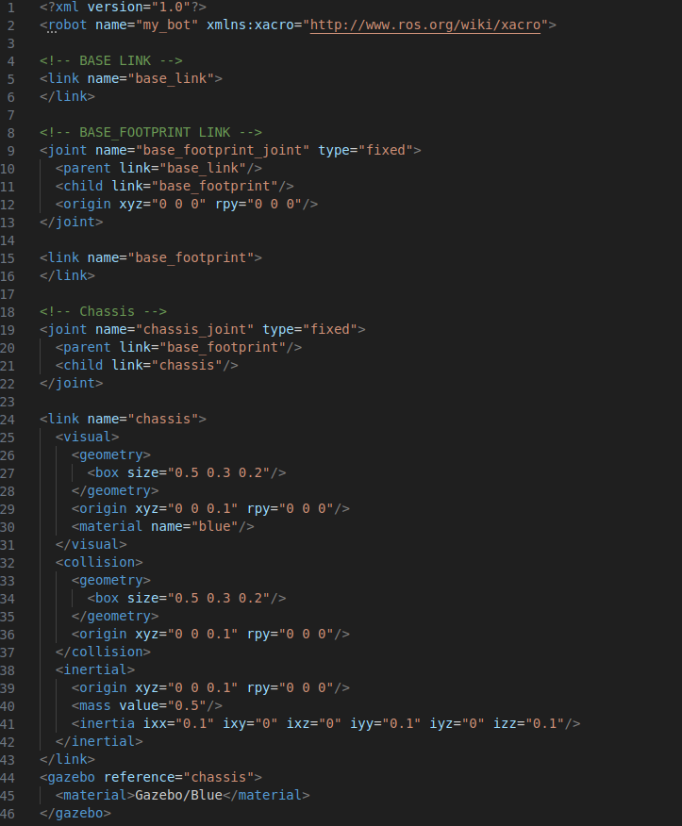

Slide 19
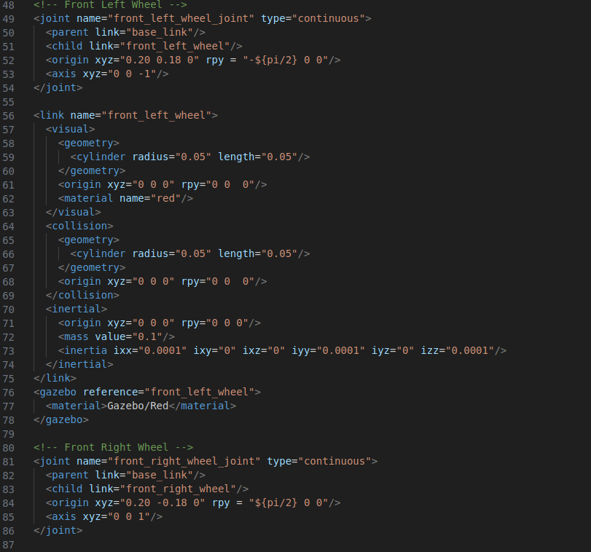

Slide 20
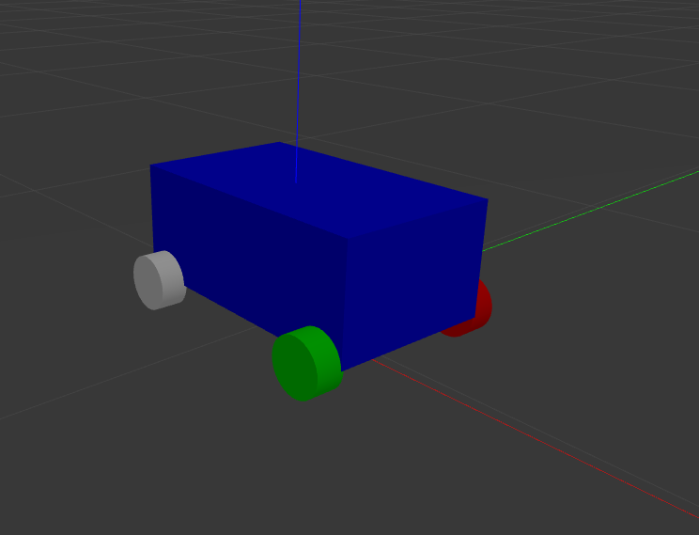

Slide 21
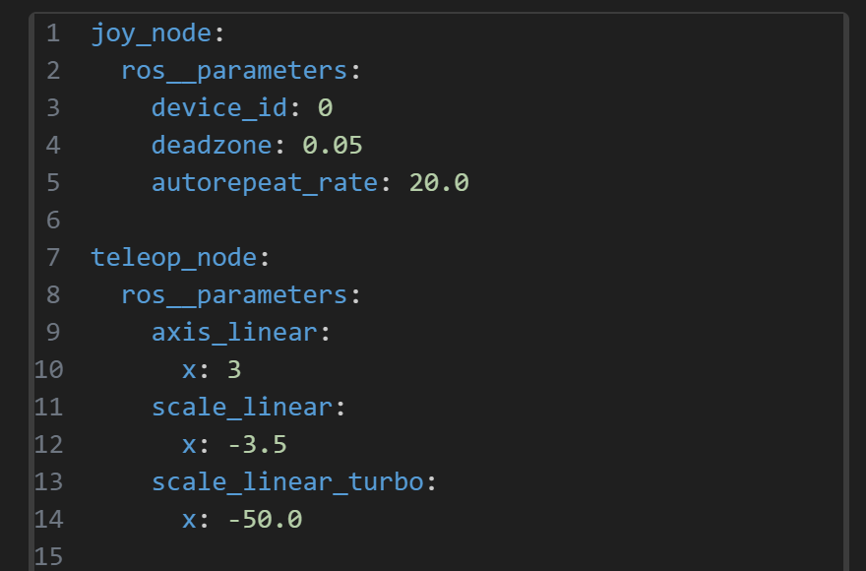
Joystick

Slide 22
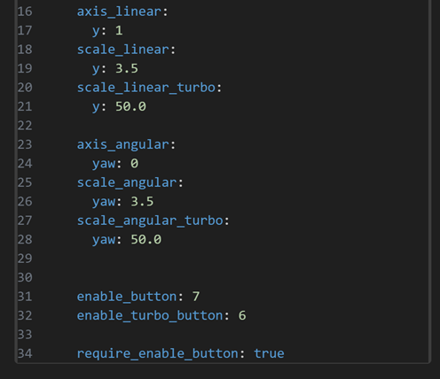
Joystick

Slide 23
GAZEBO Simulation
In the virtual realm of Gazebo, we simulate the dynamic and agile movements of an omnidirectional robot.

Slide 24

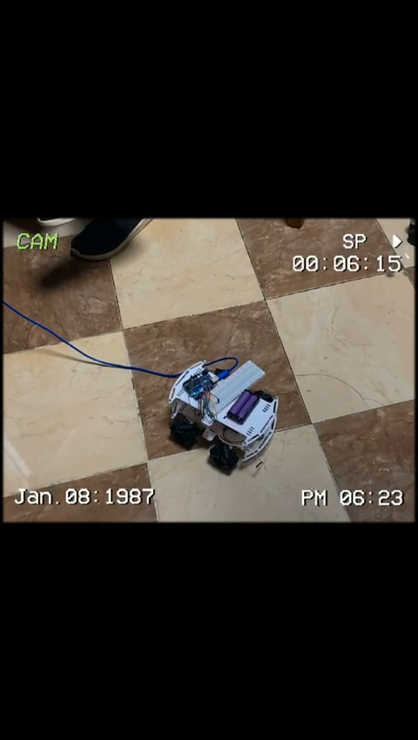
Demonstration

Slide 25
Our Team
Osama Khalil Ammar – 120210051
Radwa Waheed – 120200228
Mostafa Ahmed –120200214
Omar Al-Shamly –120190093 Mohamed Khaled –120210346

